Slide 1


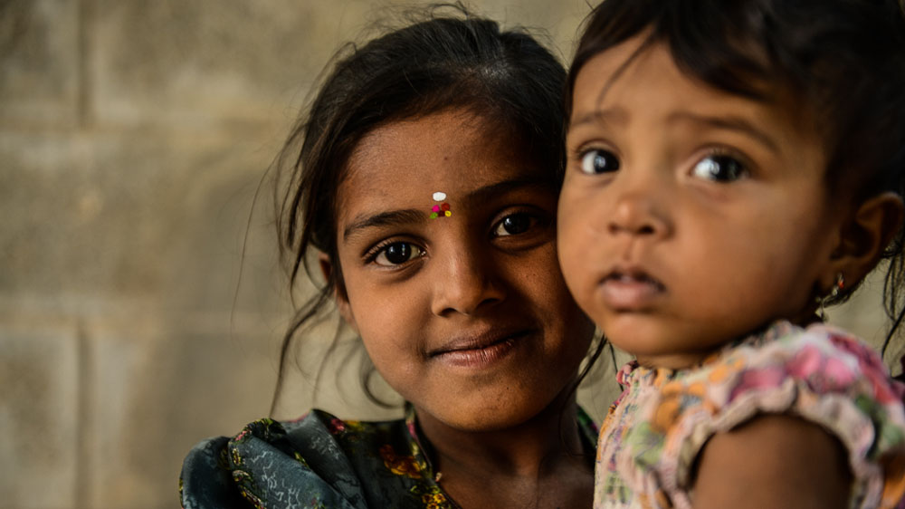
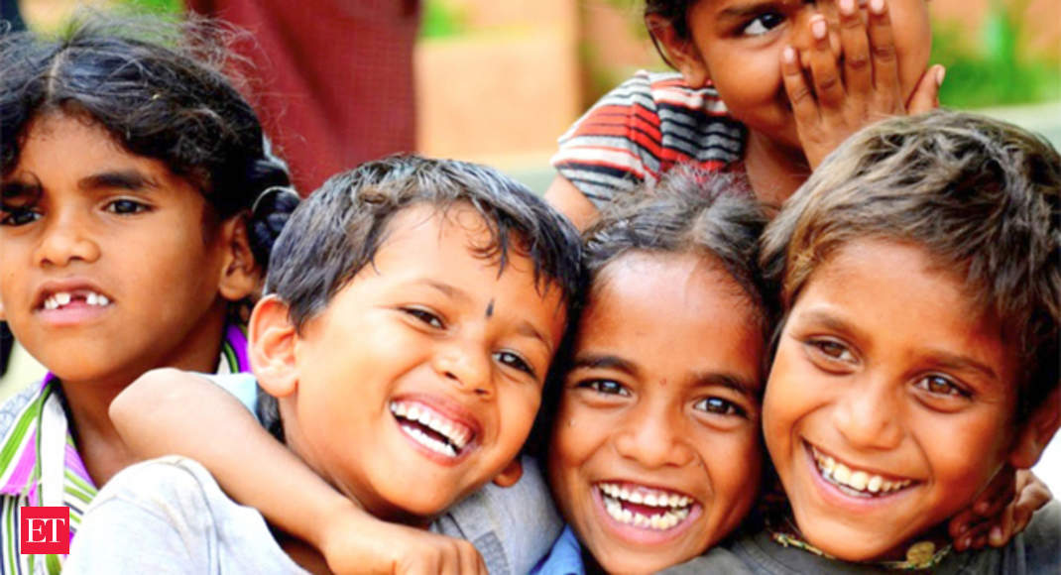
Sewa india
BUNDELKHAND INSTITUTE OF ENGINEERING AND TECHNOLOGY,JHANSI
SUBMITTED TO- SUBMITTED BY-
ER UMAKANT AHIRWAR SIR ABHINAV ASTHANA
DIVYANSHI SACHAN
SAGAR GAUD
SHIVANSHU SINGH

Slide 2
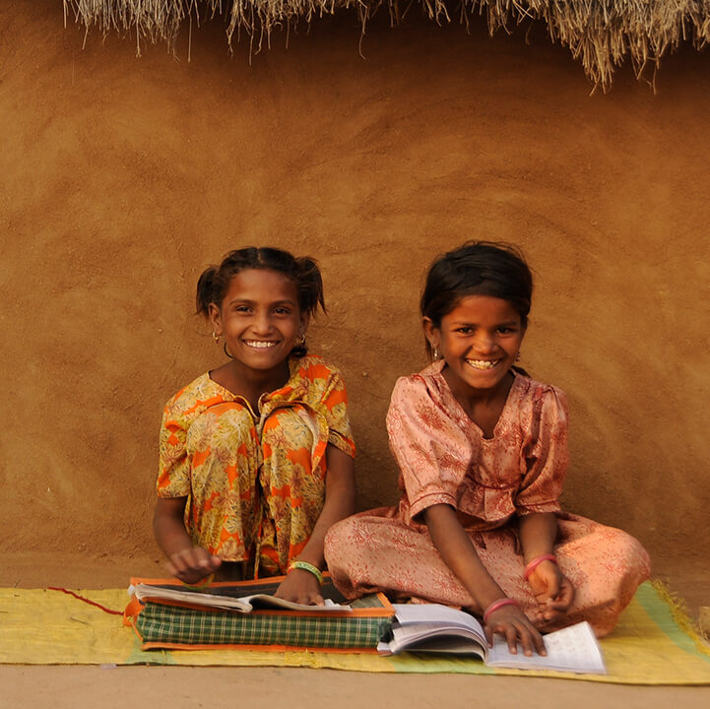
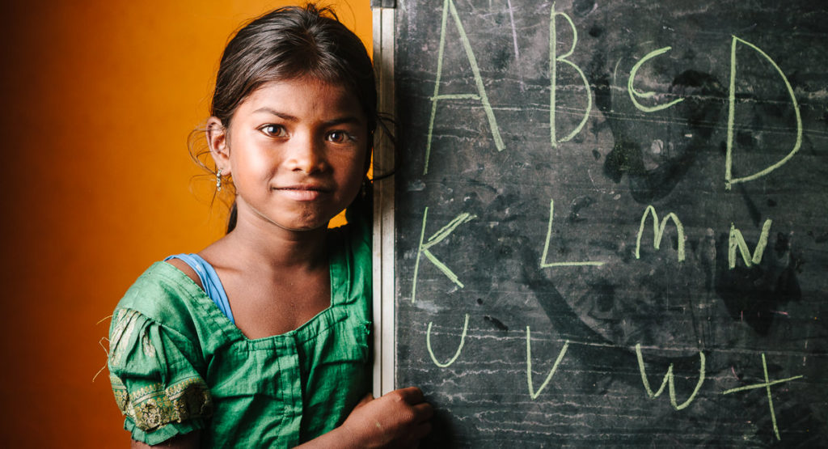
OUTLINE
INTRODUCTION TO SEWA.COM
OBJECTIVES
SOFTWARE AND HARDWARE REQUIREMENTS
TOOLS AND TECHNOLOGY USED
HIGHLIGHTS
WEBSITE OVERVIEW
FUTURE GOAL OF OUR WEBSITE
CONCLUSION

Slide 3
INTODUCTION
“EDUCATION IS VERY IMPORTANT FOR US,AS IS HELPING CHILDREN”
As the above statement states, children are future of the NATION.So,this is the aim of our website SEWA.COM to help the poor children.
Basically,Sewa.com helps children in the following ways:
By providing them books,clothes and medicines with the help of amount collected from donation.
By providing them scholarships for their education.
By ensuring their health and nutrition like-providing clean water for drinking,regular health checkups etc.
By informing them about various programmes and schemes initiated by the government to help poor children.

Slide 4

OBJECTIVES
The objectives of Sewa.com are-
To ensure education in poor section of society that will result in overall development of nation.
Giving poor children a better health.
Creating awareness about the government schemes and programmes.
Providing clothes,medicines and other essential accessories.

Slide 5
SOFTWARE AND HARDWARE REQUIREMENTS
SOFTWARE REQUIREMENTS-
NAME OF COMPONENT | SPECIFICATION
Operating system | Windows Operating System/Linux/Mac OS
Environment | ATOM,Google Chrome
Net Framework | Version 4.5

Slide 6
HARDWARE REQUIREMENTS-
NAME OF COMPONENT | SPECIFICATION
Processor | Intel core i3 or equivalent
Memory | 2GB
Disk Space | 500MB of free disk space
Video Card | Integrated graphics
Processor speed | 1GHZ or more

Slide 7
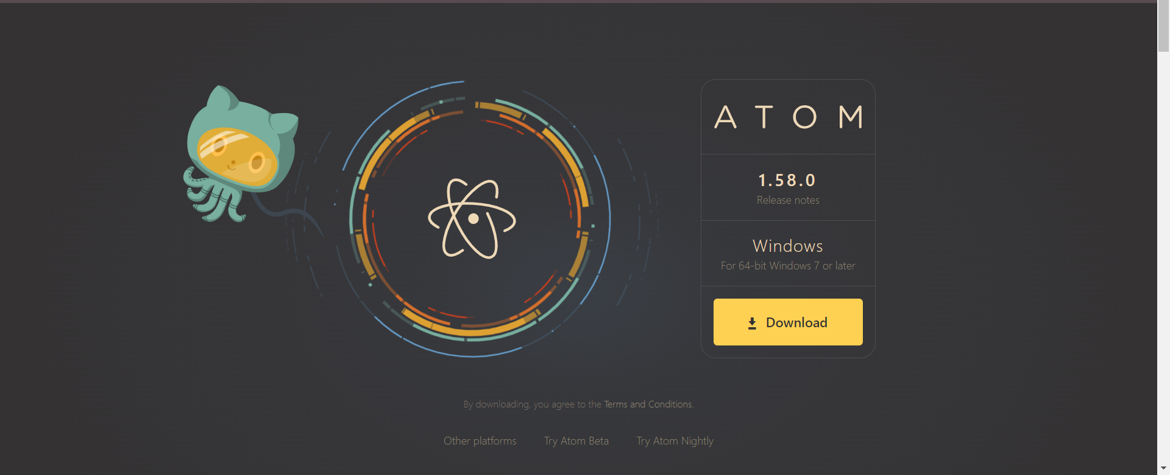
TOOLS USED-

Slide 8

TECHNOLOGY USED-
HTML
CSS
JAVASCRIPT
BOOTSTRAP
jQUERY

Slide 9
USE OF HTML-
HTML (Hypertext Markup Language) is the code that is used to structure a web page and its content.
For example, content could be structured within a set of paragraphs, a list of bulleted points, or using images and data tables.
HTML describes the structure of a web page semantically and originally included cues for the appearance of the document.
USE OF CSS-
CSS-CASCADING STYLE SHEET
CSS is used for defining the styles for web pages.
It describes the look and formatting of a document which is written in a markup language.
It provides an additional feature to HTML.
It is generally used with HTML to change the style of web pages and user interfaces.
CSS helps us to control the text color, font style, the spacing between paragraphs, sizing of columns, layout designs, and many more.

Slide 10
USE OF JAVASCRIPT-
It allows us to add dynamic behavior to the webpage and add special effects to the webpage. On websites, it is mainly used for validation purposes. JavaScript helps us to execute complex actions and also enables the interaction of websites with visitors.
USE OF BOOTSTRAP-
Bootstrap is a framework to help you design websites faster and easier.
It includes HTML and CSS based design templates for typography, forms, buttons, tables, navigation, modals, image carousels, etc.
It also gives you support for JavaScript plugins.
Bootstrap's responsive CSS adjusts to phones, tablets, and desktops.
USE OF JQuery-
jQuery is a JavaScript library that helps to simplify and standardize interactions between JavaScript code and HTML elements. JavaScript allows websites to be interactive and dynamic, and jQuery is a tool that helps streamline that process.

Slide 11
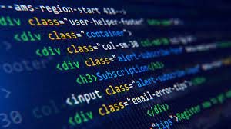
HIGHLIGHTS
Introduction of payment gateway using jQuery.
Making our website responsive.
Our login and sign up page.

Slide 12
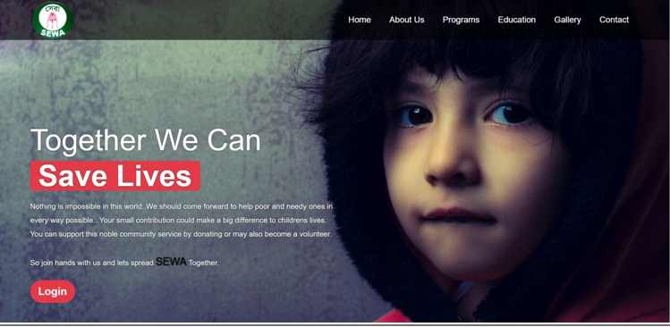
Website Overview
Home page-

Slide 13
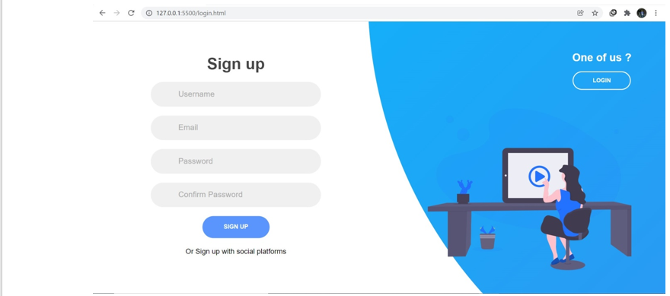
Sign up page-

Slide 14
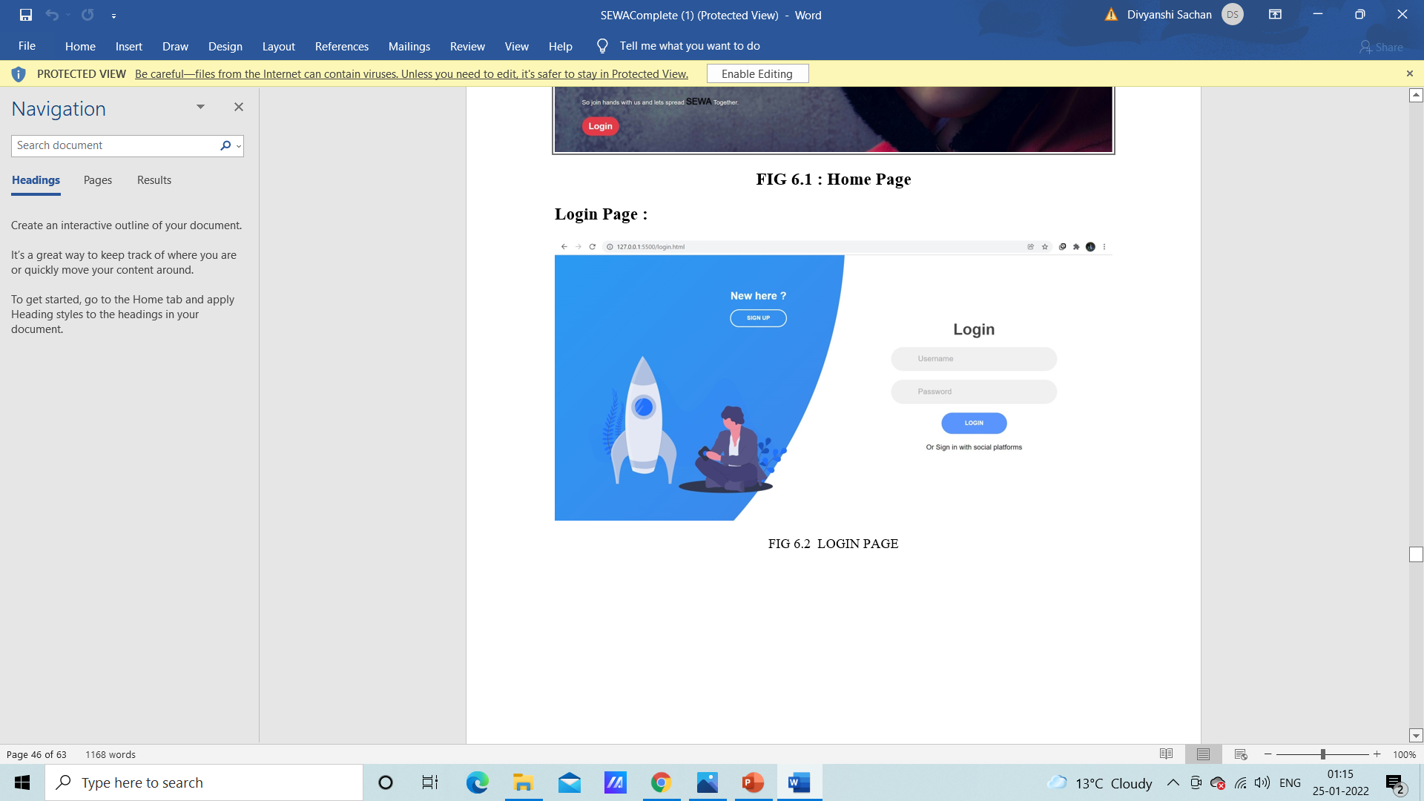
Login page-

Slide 15
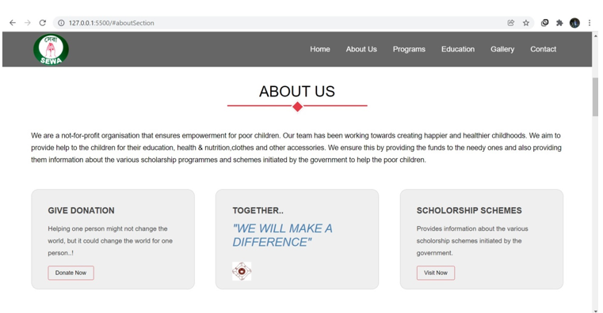
About Us section-

Slide 16
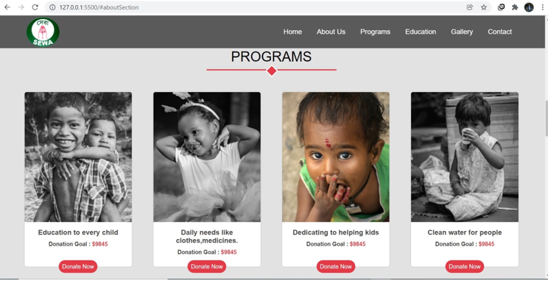
Programs-

Slide 17
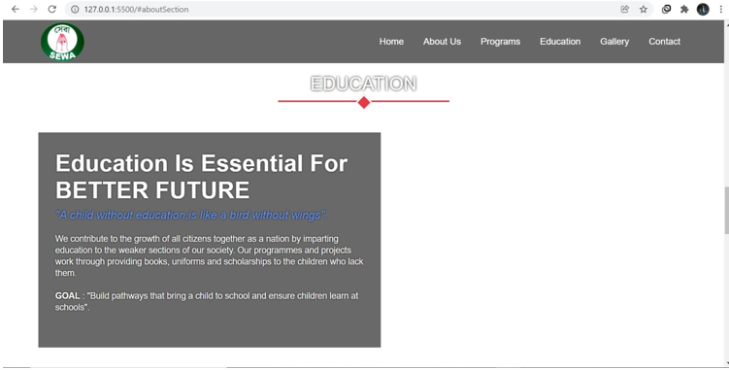
Education section-

Slide 18

FUTURE GOAL
The goals of our team with Sewa.com are-
Helping poor children in future with the help of our website.
Adding few things to make the website different and attractive.
Joining hands with some more people and starting a NGO to help children.

Slide 19
CONCLUSION
Our project is an initiative to help poor children.People can donate amounts as per according to their wish and the donated amount will be collected by the volunteers to purchase essential accessories for children and also for providing them scholarships for their education.People can join hands with us.
We have created a user-friendly interface with our website that will enable both children and the people who wants to donate to access it easily.The contact details,login form etc are available on the website for any queries.
Sewa.com will help people in giving their contribution towards creating happier and healthier childhoods and this will result in overall development of the nation.

Slide 20

THANKYOU

